Slide 1
Smart Travel Guide: Application for Android Mobile
c.anitha,sai harshitha chatla,chandhini bj

Slide 2
Introduction:
Nowadays, people’s consumption structure is improving steadily.
There has been a large increase in the number of people out on tours, for the sake of recreation and entertainment.
Tourism is the strongest and largest industry in the global economy world, generating an estimated 11% of the global gross domestic product (GDP) and employing 200 million people and serving 700 million tourists worldwide-a figure which is expected to double by the year 2020.
Meanwhile, there is greatly enriched travel information provided to the tourists on the Internet.
However, a problem is shown that tourists are not able to get travel information timely when they are on the move.
Therefore, we intend to explore how to build a mobile tourist guide system based on mashup technology to solve this problem.
Current mobile services are enhanced with locationaware features, providing the user with better use experience.
A great number of mobile phone applications appeared recently, many of which are location-related. Location-dependent services, which answer location-related queries, are an important class of context-aware applications.

Slide 3
With kinds of promising applications, like local information obtain (traffic condition, navigation messages and so on) and neighboring environment queries, such as finding the nearest restaurant, location-dependent query service will soon become an necessary part of our daily lives.
We will describe the design, implementation and deployment of a location-based application, named Smart Travel Guide, with the mobile phone as a platform. This application permitted users to get tour guidance information they need anytime and anywhere. In particular, the tourist data could be browsed or queried through an Internet map service such as Google Maps.
The mobile client’s current location is one of the most important information for location related system.
Mobile phones need to report their own locations to the remote server periodically, so that the information they want can be suitably queried.
From the point of view of the service, the simplest method of locating is to let user tell his or her location, but this method requires extra effort because the user needs to define his or her location and input it to the system.
The user can be located with different positioning systems.
The advantage of this method is that the users do not need any extra equipment.
GPS has become a mainstay of transportation system worldwide.

Slide 4
It provides accurate location information for an unlimited number of people a . GPS has become a mainstay of transportation system worldwide.
It provides accurate location information for an unlimited number of people anywhere in the world.
nowhere in the world. GPS satellites broadcast signals from space which are picked up and identified by the receivers, then the receiver are provided with three dimensional locations: latitude, longitude and altitude.
If the user device includes a GPS (Global Positioning System) module which is becoming increasingly common in current mobile devices, the user’s location can be defined very accurately [1].

Slide 5
Advantage & Disadvantage of Existing System:
In the tourism industry, tourist information is obtained mainly through newspaper, magazines, radio and other simple ways those are available easily. But problem is that tourists are not able to get travel information timely when they are on the move.
While today's mobile devices are becoming more intelligent, compared with PC, they still have the following limitations like small screen and tiny keyboard, limited CPU capacity, limited memory space, slow and fitful Internet connection. Many mobiles of recent decades have travel guide application.
But the application on these mobiles works slow due to continues acquisition of the bandwidth.
Therefore, the mobile end-user’s operation is very difficult, and the contents display on the screen of mobile device is limited [1].

Slide 6
Basic Concept of Application:
The application aims to develop detailed texts, pictures, videos and other guidance information are provided, and so people can better understand the tourist attractions and make decision objectively.
A problem is shown that tourists are not able to get travel information timely when they are on the move.
Therefore, we intend to explore how to build a mobile tourist guide system based on mashup technology to solve this problem.
Modules in Application:
Find Current Location
Locate in Map
Calculate Distance between two Cities
Video Search
Weather Forecast

Slide 7
Smart Travel Guide for Android Mobile Application:
The main objective of this paper is when users are on the move, it is able to provide rich and concise information timely and make them access to the service at anytime and anywhere.
The proposed system is based on request and response, so there is no continuous acquisition of the bandwidth [2].
Mobile Tourist Guide System Based On Mashup :
Mashup technology is a useful for this application. Along with web-based applications becoming richer and related technologies becoming more mature, Mashups based on open web APIs have shown the power of integrating applications and data sources to create novel and situational web services to serve needs of users.
A mashup can combine two or more data sources (content or service) to provide several new services or contents to the users.
More importantly, it is a lightweight web application program. The data or contents are mashed up in the mashup server side.
Furthermore, no matter what the mobile client is a Web browser or not, it is able to understand the format of the data or contents.
The advantage of mashup technology is greatly exploited for the application of mobile devices.
In this section, we first present the architecture of the mobile tourist guide system. Then the functions of main components are detailed and how the system helps tourists get the best attractions is also discussed.

Slide 8
System Details:
In this section the detail overview of the system is given.
It includes System architecture which describes the basic architecture of system, main components of Mashup Server, Communication protocols, working flow of the system.
System architecture:
The architecture of this system contains three layers: presentation layer, logical layer and Data Sources layer.
Presentation layer provides the interaction between the end-users and the system. The mobile end-users usually interact with mashup server through the mobile Web browser. Because of the limitations of mobile device, the content displaying issue needs to be addressed in this layer.
Logical layer is the most important layer of the system. It deals with data and services from the data sources layer and the mobile end-users.
The transformation of XSL converts the format of XML which is from the data source layer into the format of WML (Wireless Markup Language), which is ability to deliver the result to the mobile Web browser by the Wireless Application Protocol (WAP).
Data sources layer provides data, content and service to be mashed-up by the open web APIs and databases.
Currently, more and more websites provide API to the developers and researchers.
The APIs of Google Maps is the most widely used in the diverse areas. The most popular protocols used by the APIs are REST (Representational State Transfer), SOAP (Simple Object Access Protocol), and RSS/Atom

Slide 9
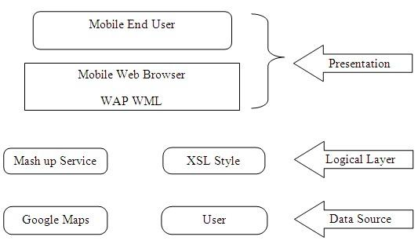
For those data in the silo, we can extract the content using other technologies such as screen scraping.
These protocols which have their own advantages should be chosen according to the actual needs. Therefore, we choose Google Maps API, as the data sources.
The mashup server communicates with data sources based on APIs by REST. [1]
Fig. 1 System Architecture

Slide 10
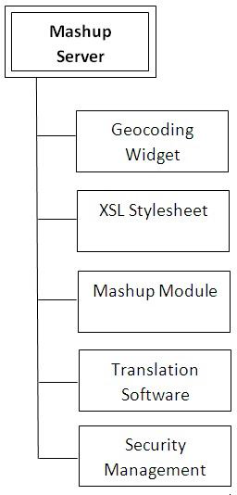
The Main Components of Mashup Server:
Geocoding Widget converts end-user’s location information into latitude and longitude coordinates that Google Maps can identify and mark in the maps.
XSL StyleSheet the data or contents from data sources that is XML format need to be transformed into WML format by the XSL StyleSheet.
Therefore, Mobile service providers can efficiently use existing resources to provide better services.
Fig. 2 Components of Mashup Server

Slide 11
The translation software is designed to solve the language problems from domestic and foreign tourists.
Mashup module this component is the most important part of the mashup server. It determines what kind of services will provide to the mobile end-users. Data sources transfer the data or contents to the mashup server according to the receiving command.
Due to the limitation of mobile device screen, the received data or contents need to be simplified by the information extraction technology.
Then, the data or contents from different data source are mashed up into the maps, which are provided to the mobile end-user.
Security Management mashup technology emphasizes openness, but the end-user’s private information should be protected.
This is contradictory, so how to effectively collect (and protect) end-user’s information is a problem.
In this system, the end-user’s sensitive information (e.g. location information, phone number) will not be publicized, because we use specific algorithm to exploit the end-user’s individual requirements.
This will not only protect the endusers sensitive information but also sufficiently utilize the end-users information in the mashup application.

Slide 12
Communication Protocols:
The communication is a very important link of the system. It is to connect data or contents with each layer.
Although WSDL (Web Services Description Language), SOAP, JSON(JavaScript Object Notation) and REST are the standard for delivering data or contents between mashup server and data sources, REST is abstraction mode which is a more effective for the server mode.
Compared to SOAP, it is more like structure style, not only a specification, so the complex protocols are not taken into account.
Therefore, we choose REST to communicate among mashup server, Google Maps.
The Working Flow of the System:
In this section, we will present the working flow of the mobile tourist guide system.
First of all, we assume that the mobile end-users have already registered with the system and provided their personal information Fig.3 shows the working flow of the application in details.
In Step1, 2, 3 the mobile end-user logs on the system through the mobile web browser on his/her mobile device and sends request to the mashup server.
To respond, the mashup server returns a Web page to the mobile Web browser. At the same time, the Web page will trigger the GPS (Global Position System).
It is necessary to add a timer to the Webpage, so that the GPS is able to update user’s geographical positioning information to the mashup server in time.

Slide 13
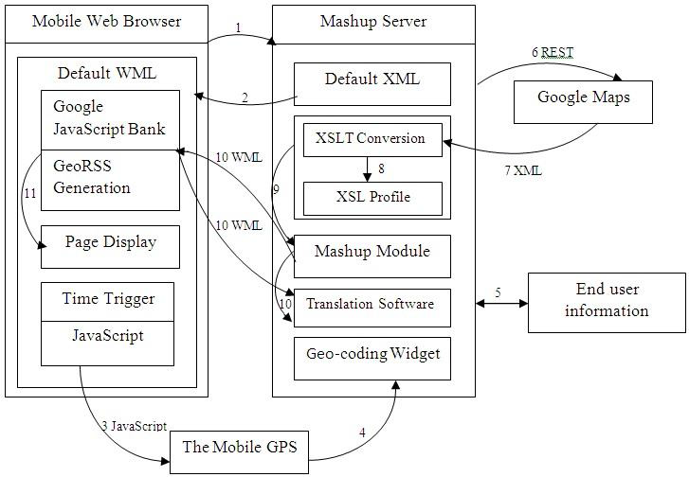
mobile end-user is delivered to the mashup server.
Meanwhile, the end-user’s information is also sent to the mashup server. In step5 the mashup server analyzes the user information stored in the databases to obtain the user’s preference requirements.
Simultaneously, as the content of Yahoo Travel is in English, the Mashup server determines whether it is necessary to use the translation software through the analysis. In step6, 7 the Geocoding Widget on the Mashup server first transforms the user’s geographical positioning information into latitude and longitude values.
Then the latitude and longitude values are delivered to the Google Maps Server by mashup server through REST protocol.
Fig.3 System Flow

Slide 14
Thus, Google Maps Server is able to Mark the location of the user on the map. The map pictures which are usercentric are fed back to mashup server with XML over HTTP.
In step8 XSLT Conversion converts XML documents into WML format by using the XSL profiles.
Then, the WML documents are delivered to the Mashup module. In step9 after receiving information from Google Maps, Users Information Database and Yahoo Travel, mashup server should integrate this information based on map pictures.
Attractions, hotels in and around, and restaurants should be marked on the map pictures. In addition, when the mobile phone cursor moves to the marked dot in the map picture, it will show the relevant tourism information of the marked point. In step10 in the end, mashup server sends the result to the mobile devices.
According to the useful information provided by the system, the mobile end-users are able to follow with the tourism attractions and enjoy the cheerful travel.

Slide 15
PROPOSED SOLUTION :
The challenge address by mobile was ability to get exact location from the specified favorites, current location, map, distance between two cities, weather report, find the video.
Pointed out from the research that many applications have been developed, but some of the tourist information is mainly obtained through newspaper, magazines these applications do not provide exact information while user on move.
After studying many researches papers and also addressed many problem but the some mentioned above are the major issue so the proposed system will try to solve many problem related with current location, map, distance between two cities, weather report, find the video.
In order to help the user who is newer to the city at the traveling time and gets current location, map, distance between two cities, weather report, find the video.

Slide 16
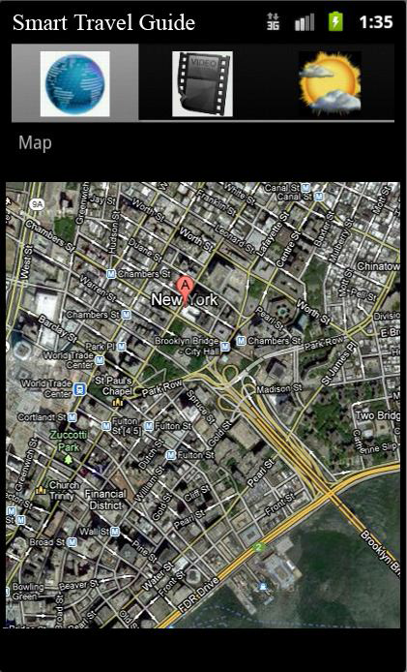
Fig 4. Locate the user in Map

Slide 17
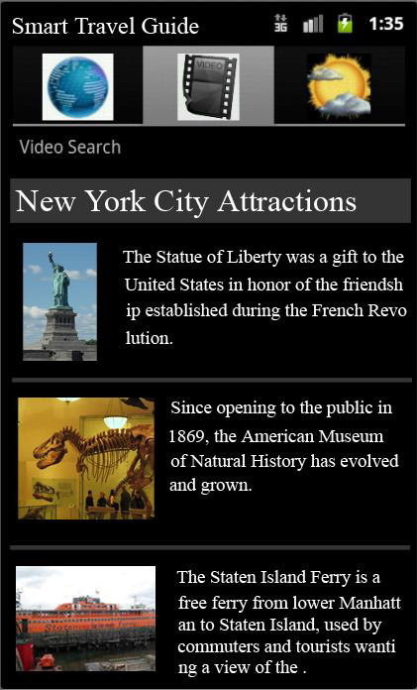
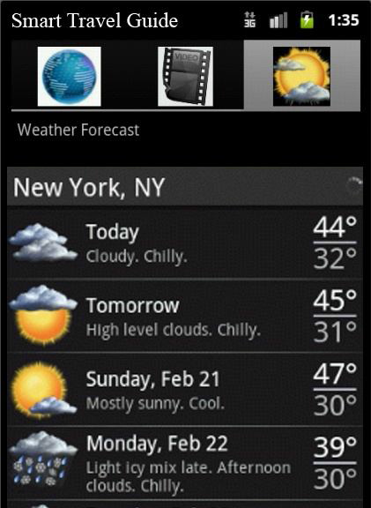
Fig 6.Weather forecast for location

Slide 18
CONCLUSION :
In this paper, we presented the design and implementation of a mobile application called Smart Travel Guide, with which mobile users can get tourism guidance information they need anytime and anywhere.
By Smart Travel Guide, users can get an attraction’s detailed information, including text, picture and video. In particular, Smart Travel Guide can provide users with location-based information, which can be browsed or queried through a map.
User can search the nearby attractions after he or she configures the distance between the current location and the view spots. When the user moves out of the current location, the mobile phone will automatically send its new position to the server side, and the corresponding attraction list will be received by the user.
REFERENCES:
[1] Jian Meng,Neng Xu ,“A Mobile Tourist Guide System Based on Mashup Technology“ ISBN978-1-4244- 7618-3 /10 ©2010 IEEE.
[2] Xiaoyun shi,”Tour-Guide: Providing Location-Based Tourist Information on Mobile Phones “ISBN 978-1-4244-7547-6/10 @2010 IEEE.

